Slide 1


Slide 2

Sathish Nadarajan
Solution Architect, AstraZeneca

Slide 3
What’s New Azure Cognitive Services

Slide 4
Agenda
Cognitive Services
Health-Bot
Form Recognizer
Spatial Analysis
Text Analytics for Health
Gated Cognitive Services
https://aka.ms/csgate

Slide 5
Cognitive Services
Azure Cognitive Services are cloud-based services with REST APIs and client library SDKs available to help you build cognitive intelligence into your applications. You can add cognitive features to your applications without having artificial intelligence (AI) or data science skills. Azure Cognitive Services comprise various AI services that enable you to build cognitive solutions that can see, hear, speak, understand, and even make decisions.
Categories of Cognitive Services
The catalogue of cognitive services that provide cognitive understanding are categorized into five main pillars:
Vision
Speech
Language
Decision
Search

Slide 6
Health Bot
The Azure Health Bot service empowers healthcare organizations to build and deploy an AI-powered, compliant, conversational healthcare experience at scale. The service combines built-in medical intelligence with natural language capabilities, extensibility tools and compliance constructs, allowing healthcare organizations such as Providers, Payers, Pharma, HMOs, Telehealth to give people access to trusted and relevant healthcare services and information.
Deliver intelligent, conversational healthcare experiences at scale
Integrates medical content from trusted sources including information on conditions, symptoms, specialists, medications and procedures
Delivers credible triage and symptom checking
Understands healthcare intents by leveraging built-in language models tuned to medical terminology
Handles interruptions, topic changes, human error and complex medical questions
Empower healthcare organizations to build and extend intelligent health assistants
Address your own specific business and use cases by easily authoring, extending, and debugging bot flows
Securely integrate with your own backend systems
Build from a library of scenario templates of common industry use cases
Optimize bot instances with built-in reporting
Offload operational and infrastructure management and maintenance
Run with confidence by leveraging a secure and compliant platform
Resiliently scale your bot instances on Microsoft Azure while maintaining the highest standards of privacy and security
HIPAA compliance by external auditors
ISO 27001, 27018, and CSA Gold certified
GDPR compliant
All data encrypted in transit and at rest
Built-in compliance constructs

Slide 7
Form Recognizer
https://fott-preview.azurewebsites.net/prebuilts-analyze

Slide 8
Spatial Analysis
The Spatial Analysis service helps organizations maximize the value of their physical spaces by understanding people's movements and presence within a given area.
It allows you to ingest video from CCTV or surveillance cameras, run AI operations to extract insights from the video streams, and generate events to be used by other systems.
With input from a camera stream, an AI operation can do things like count the number of people entering a space or measure compliance with face mask and social distancing guidelines.

Slide 9
Spatial Analysis
Feature | Definition
People Detection | This component answers the question, "Where are the people in this image?" It finds people in an image and passes a bounding box indicating the location of each person to the people tracking component.
People Tracking | This component connects the people detections over time as people move around in front of a camera. It uses temporal logic about how people typically move and basic information about the overall appearance of the people. It does not track people across multiple cameras. If a person exits the field of view for longer than approximately a minute and then re-enters the camera view, the system will perceive this as a new person. People Tracking does not uniquely identify individuals across cameras. It does not use facial recognition or gait tracking.
Face Mask Detection | This component detects the location of a person's face in the camera's field of view and identifies the presence of a face mask. The AI operation scans images from video; where a face is detected the service provides a bounding box around the face. Using object detection capabilities, it identifies the presence of face masks within the bounding box. Face Mask detection does not involve distinguishing one face from another face, predicting or classifying facial attributes or performing facial recognition.
Region of Interest | This is a user-defined zone or line in the input video frame. When a person interacts with this region on the video, the system generates an event. For example, for the PersonCrossingLine operation, a line is defined in the video. When a person crosses that line an event is generated.
Event | An event is the primary output of Spatial Analysis. Each operation emits a specific event either periodically (like once per minute) or whenever a specific trigger occurs. The event includes information about what occurred in the input video but does not include any images or video. For example, the PeopleCount operation can emit an event containing the updated count every time the count of people changes (trigger) or once every minute (periodically).

Slide 10
Text Analytics for Health
Text Analytics for health is a feature of the Text Analytics API service that extracts and labels relevant medical information from unstructured texts such as doctor's notes, discharge summaries, clinical documents, and electronic health records. There are two ways to utilize this service:

Slide 11
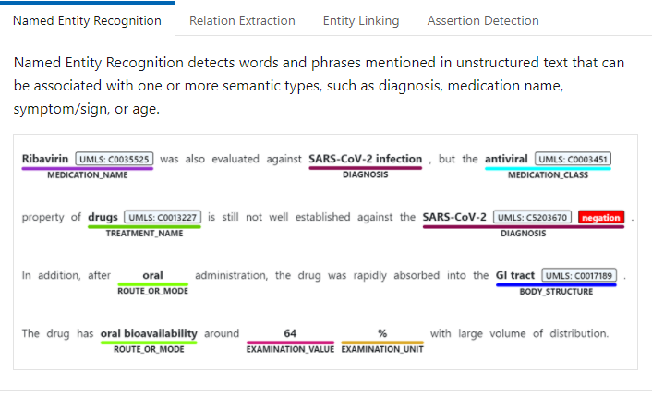
Text Analytics for Health

Slide 12
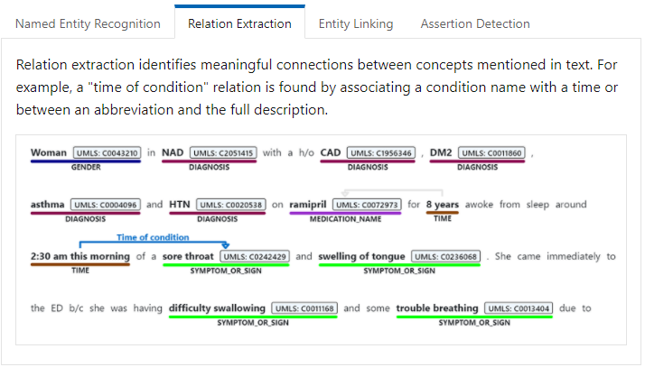
Text Analytics for Health

Slide 13
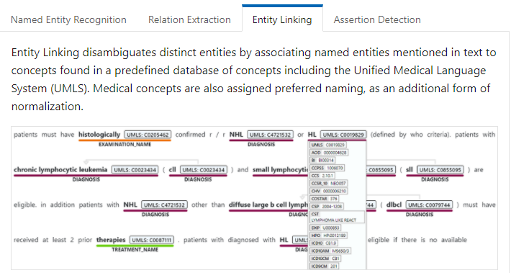
Text Analytics for Health

Slide 14
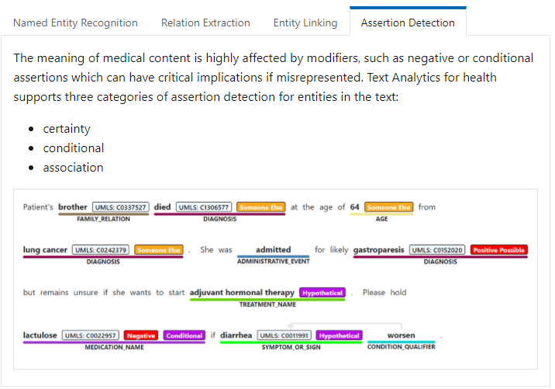
Text Analytics for Health

Slide 15
Demo

Slide 16
Thank You!

